Slide 1
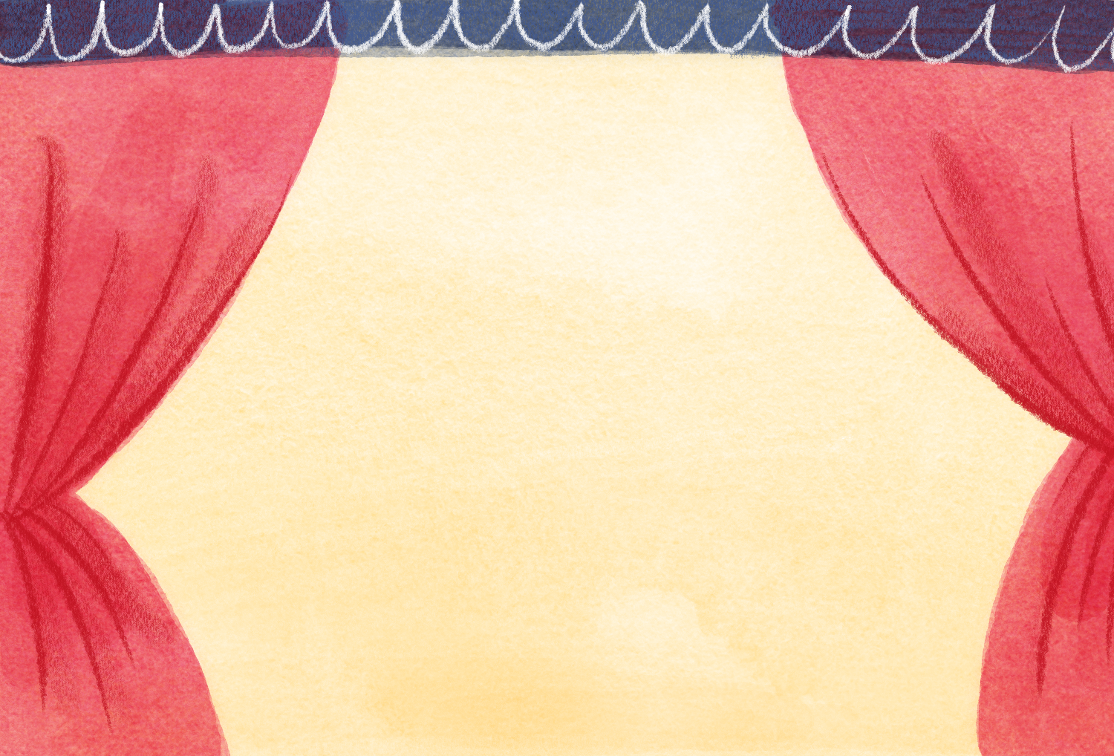
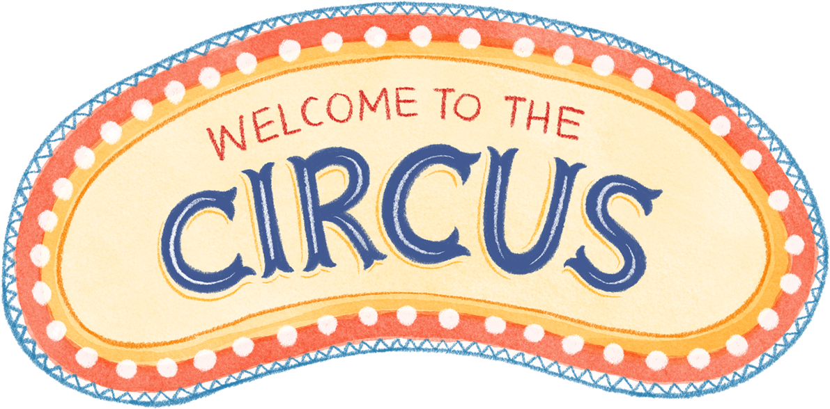
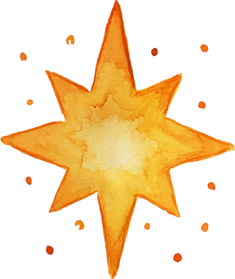
Presentation with Hand Gestures

Slide 2
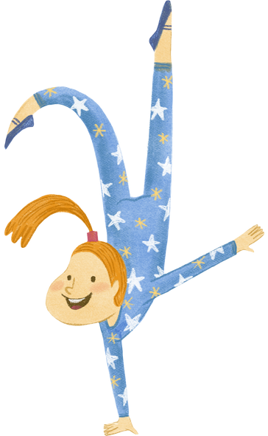
Motivation
Traditional presentations often require physical interaction with a device (clicker, mouse, or keyboard) to change slides.
Gestures can make presentations more dynamic and interactive.
This technology can be particularly useful for people with physical disabilities or conditions that make using traditional presentation tools challenging.
Minimizing physical contact with devices can be important for hygiene

Slide 3
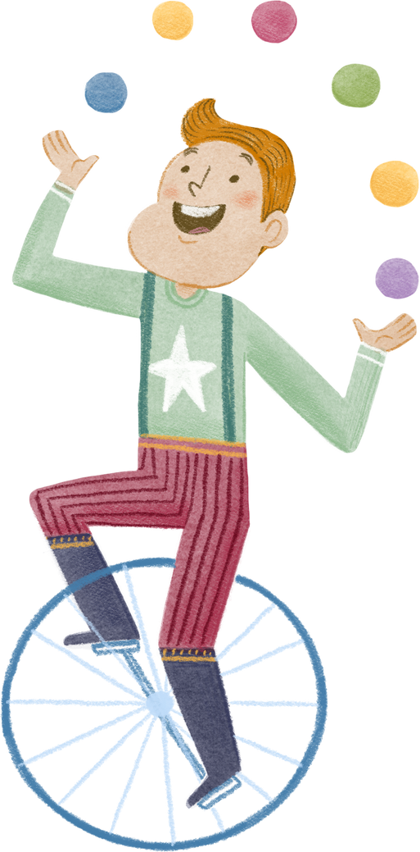
You can go forward

Slide 4
You can also go backward

Slide 5
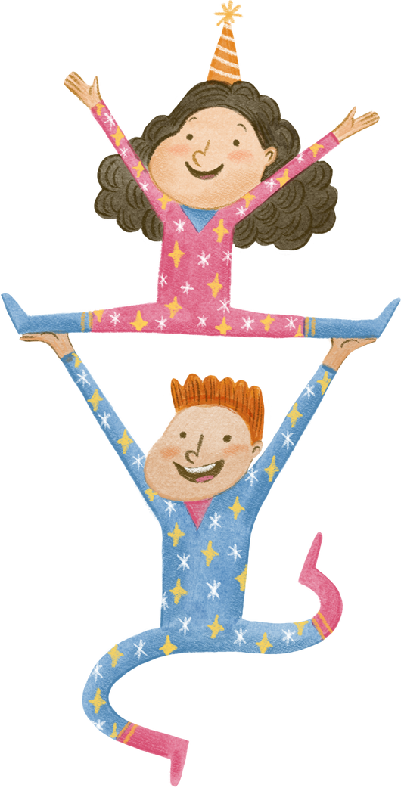
You can use a pointer

Slide 6
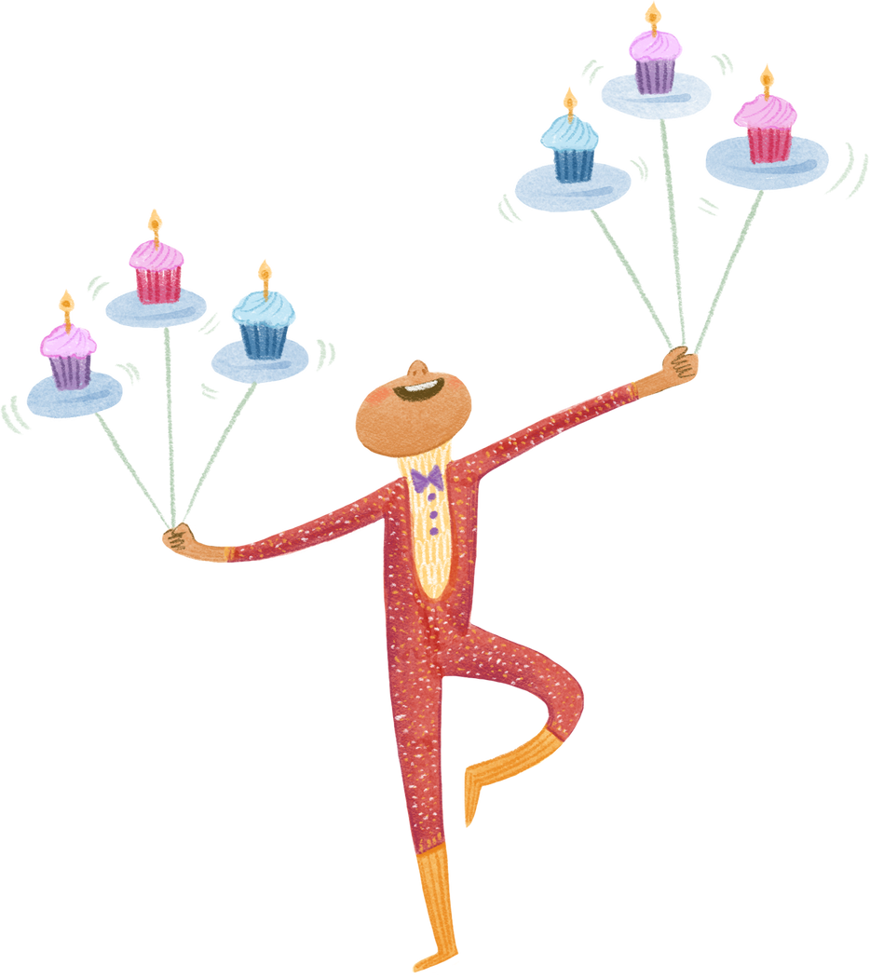
And you can draw!

Slide 7
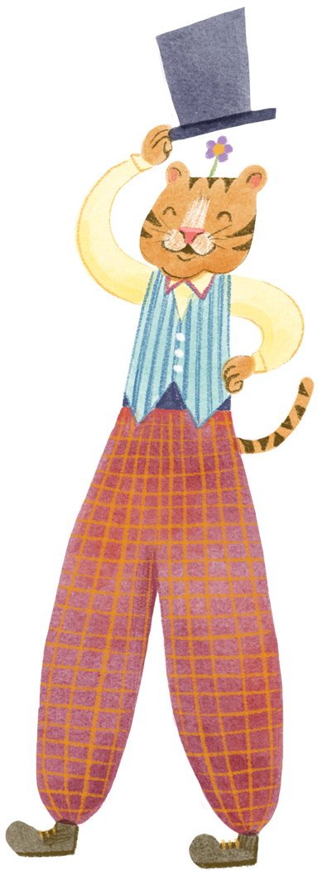
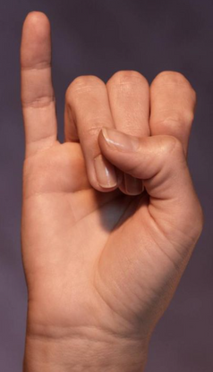
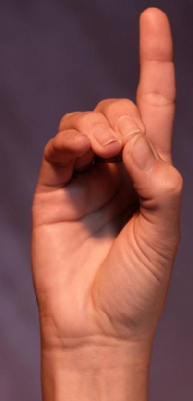
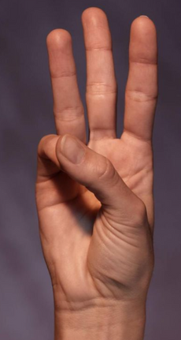
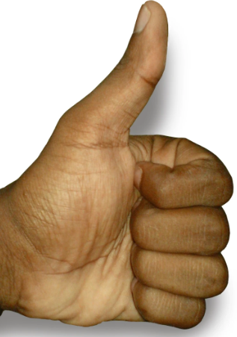
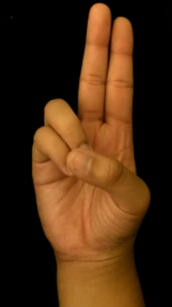
Hand Gestures
Pointer
Forward
Erase
Backward
Draw

Slide 8
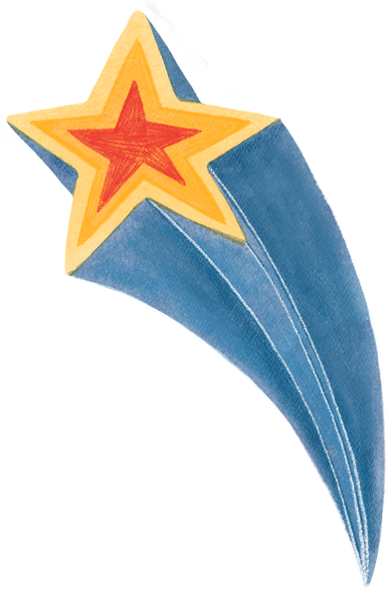


Thanks for Watching

